Slide 1

Non-Current Liabilities Part 1 – In-Class

Slide 2
From the Video
Bond payables and note payables are measured at present value of future cash flows at issuance.
Similar to how we recorded initial BV of Notes Receivable at their present value at issuance!
Notes issued for non-cash items (like PP&E) are measured at fair value of item (or PV of future cash flows if fair value unknown)
Notes and bonds can be issued at face, premium, or discount.
** Receivables: calculate Revenue → Payables: calculate Expense

Slide 3
Example (non-cash)
On January 1, 2020, Mrs. Potts Corp. purchased equipment in exchange for a $12,000 zero-interest bearing note due in two years. The equipment has a fair value of $10,000 and the market interest rate is 10%.
Prepare the journal entry for the acquisition.
Equipment (B-A) 10,000
Discount on N/P (B-XL) 2,000
Note Payable (B-L) 12,000
Fair Value Known:
CV of note = $10,000
FV of note = $12,000
Discount = $2,000

Slide 4
Example (non-cash)
On January 1, 2020, Mrs. Potts Corp. purchased equipment in exchange for a $12,000 zero-interest bearing note due in two years. The market interest rate is 10%. The present value of the note, discounted at the 10% market rate, is $9,917.
Prepare the journal entry for the acquisition.
Equipment (B-A) 9,917
Discount on N/P (B-XL) 2,083
Note Payable (B-L) 12,000

Slide 5
Example (non-cash)
On January 1, 2020, Mrs. Potts Corp. purchased equipment in exchange for a $12,000 zero-interest bearing note due in two years. The market interest rate is 10%. The present value of the note, discounted at the 10% market rate, is $9,917.
(b) Calculate interest expense for 2020.
Interest expense in Yr 1 = CV @ beginning of Yr 1x market rate
= $9,917 x 10% = 992

Slide 6
Go to In-Class Questions
In-Class Problem 1

Slide 7
Bonds
Notes:
Talk about (1) and (2) from next slide here

Slide 8
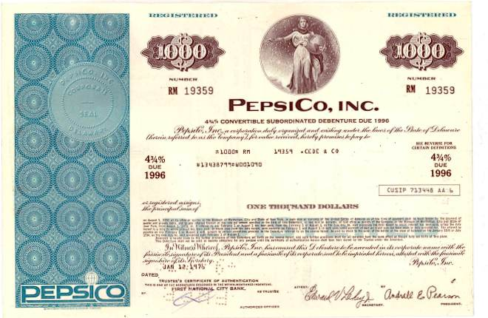
Bonds
Non-current (or long-term) liabilities are obligations due in more than one year.

Slide 9
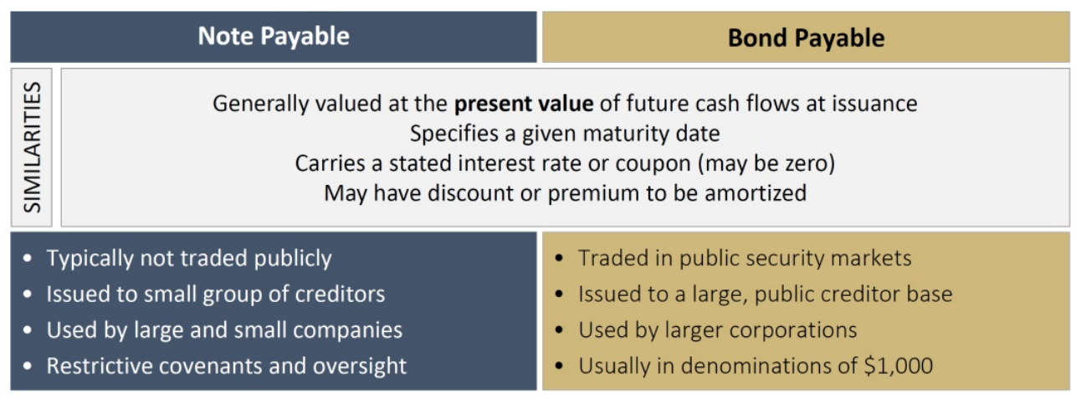
Bonds
Non-current (or long-term) liabilities are obligations due in more than one year. * Financing Activities

Slide 10
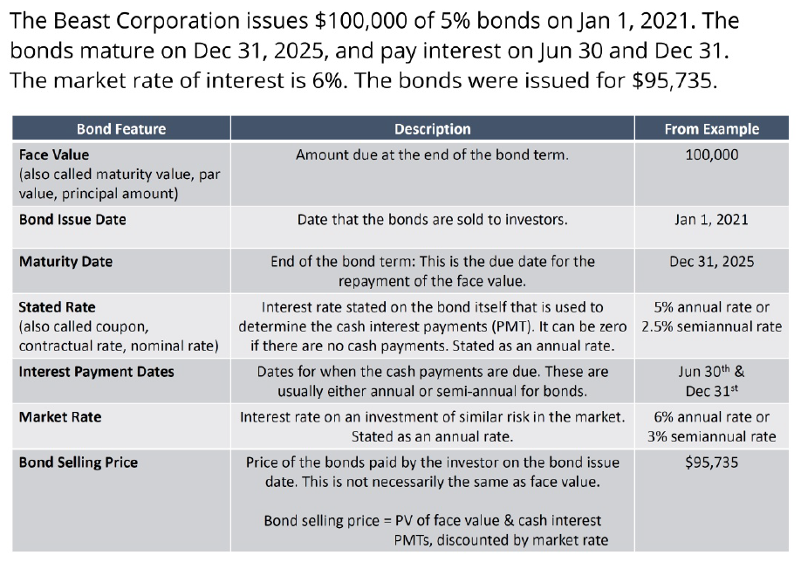
Bond Features

Slide 11

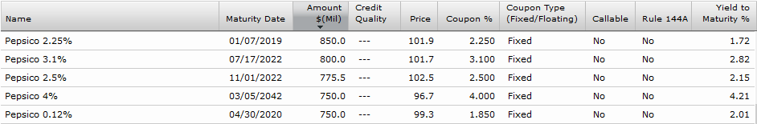
Alternative Bond Price
Price is quoted as a % of face value
→ Price x Bond Face Value = true value (i.e., current market value)
If face value of a single bond from top row is $1,000, then 101.9% x $1,000 = $1,019 true value
If face value of a single bond from bottom row is $1,000, then 96.7% x $1,000 = $967 true value
Notes:
FYI:
DEFINITION of 'Rule 144A'
A Securities & Exchange Commission rule modifying a two-year holding period requirement on privately placed securities to permit qualified institutional buyers to trade these positions among themselves.
DEFINITION of 'Yield To Maturity (YTM)'
The total return anticipated on a bond if the bond is held until the end of its lifetime. Yield to maturity is considered a long-term bond yield, but is expressed as an annual rate. In other words, it is the internal rate of return of an investment in a bond if the investor holds the bond until maturity and if all payments are made as scheduled.

Slide 12
Three Ways to a Bond Price
Calculate a PV using the current market rate
We won’t do this in this class.
Problem gives you a cash value/present value (e.g. sold for $1,500,000)
Problem gives you a price (price = 102.900, implying the bonds sold for 102.9% x Face Value or 1.029 x Face Value)
We might say: “the bonds are sold at 102.9.”

Slide 13
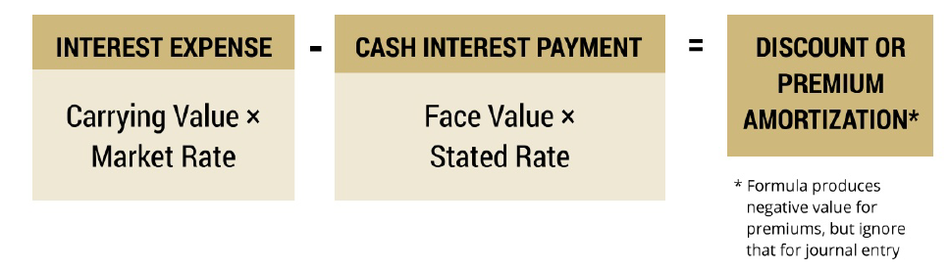
Amortization (again)

Slide 14
Three Rules for Bonds
Initial Book value or Carrying Value = Present value of future cash flows.
Interest expense = beginning book value X market rate.
Coupon payment = coupon rate X face value.

Slide 15
Go to In-Class Questions
Problem 2

Slide 16
Non-Current Liabilities Part 1 – In-Class

